Slide 1
AUTOMATED PAPER CRAFTING MACHINE
MEHAK
SAMRIDDHI
YASH

Slide 2
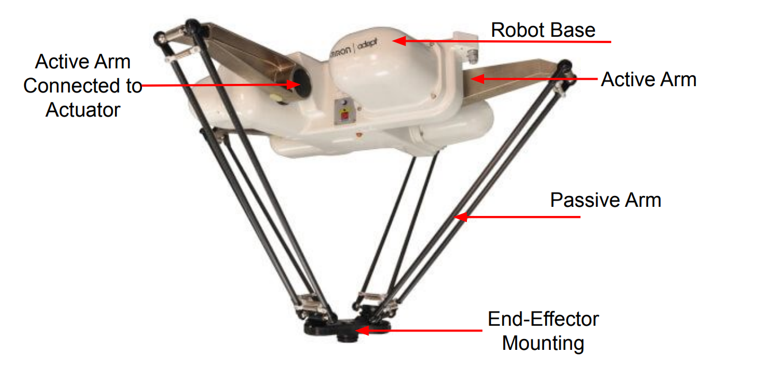
PROBLEM STATEMENT
Design an automated machine from pre-cut paper to create structures like flowers, houses etc.
PROPOSED SOLUTION
We propose a portable automated machine that uses a delta robot for precise pick-and-place of pre-cut paper, applying glue and assembling them on an A4 sheet to create intricate structures like flowers and houses.

Slide 3
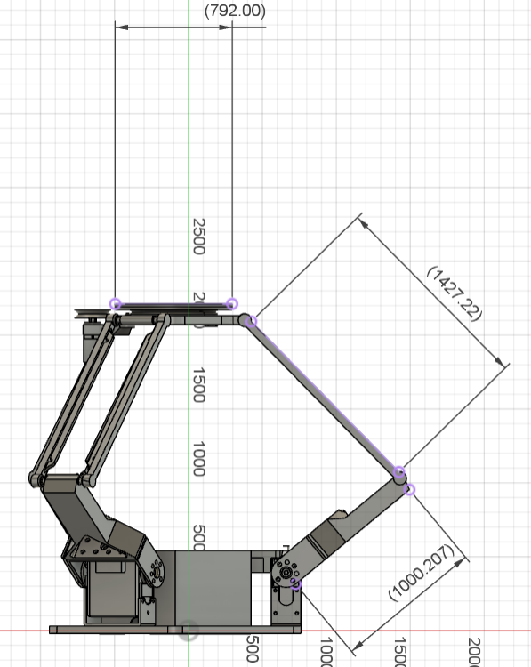
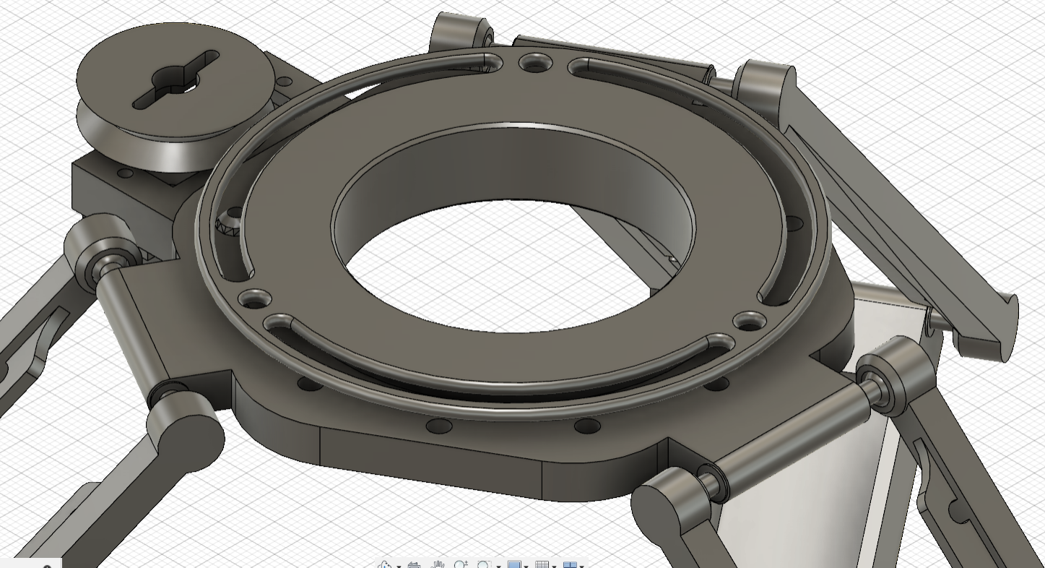
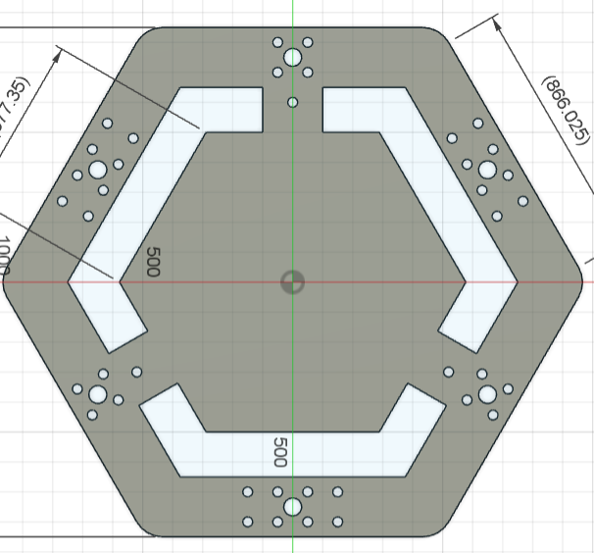
DELTA ROBOT: DIMENSIONAL OVERVIEW
8 cm
End-effector
15 cm
Base of Delta-Robot
17 cm
10 cm

Slide 4
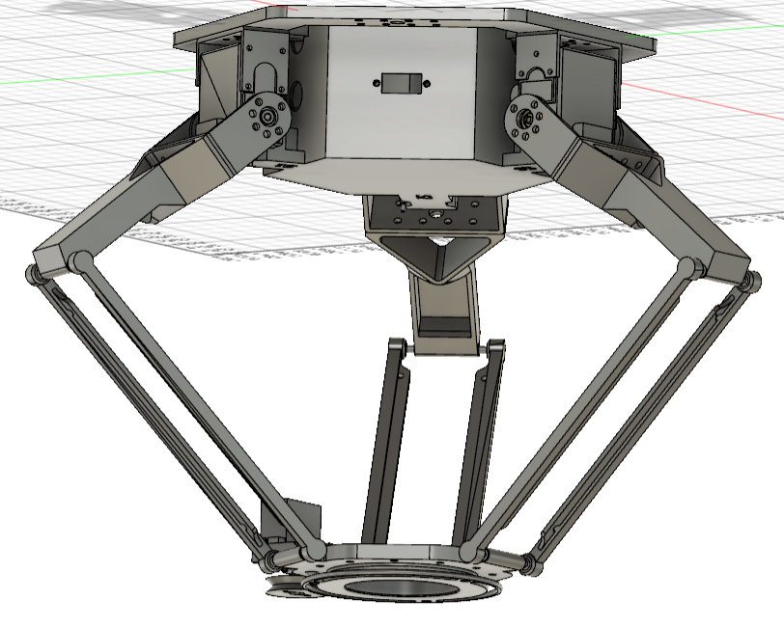
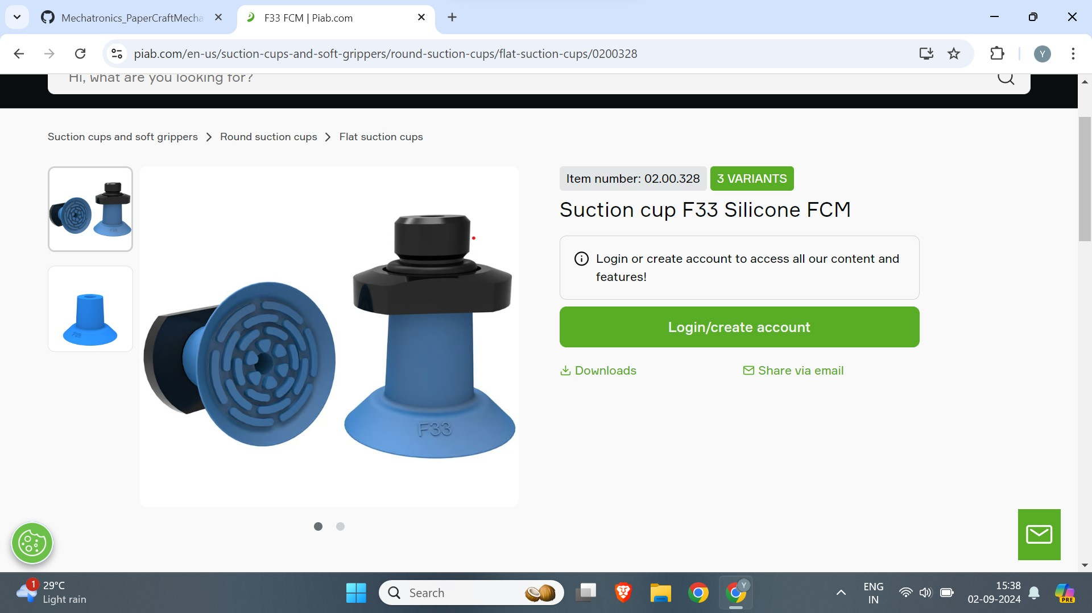
WORKING MECHANISM
Pre-cut
paper
A-4
Size
paper
Servo-motor
40 cm
Arm
Gluing area
30 cm
Base
Vacuum gripper
(side and front view)

Slide 5
MECHATRONICS ARCHITECTURE
Servo 1
Servo 2
Servo 3
Vision Sensor
Raspberry Pi
Battery
Servo END effector
Solenoid Valve
Vacuum Gripper

Slide 6
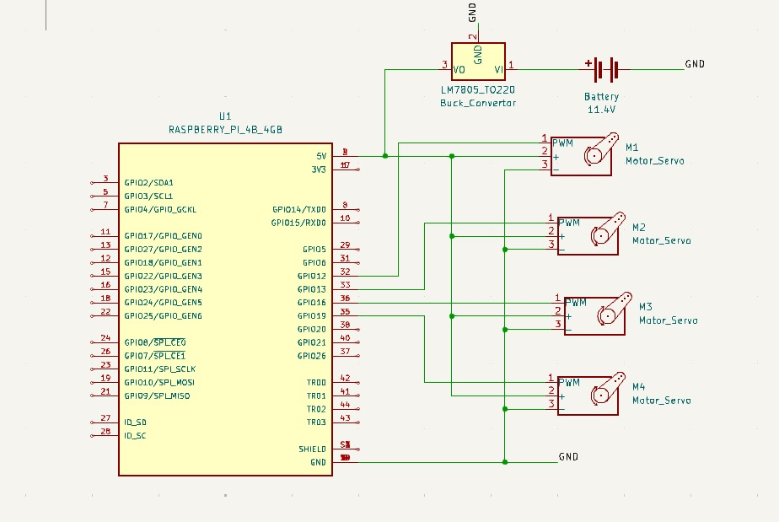

Slide 7
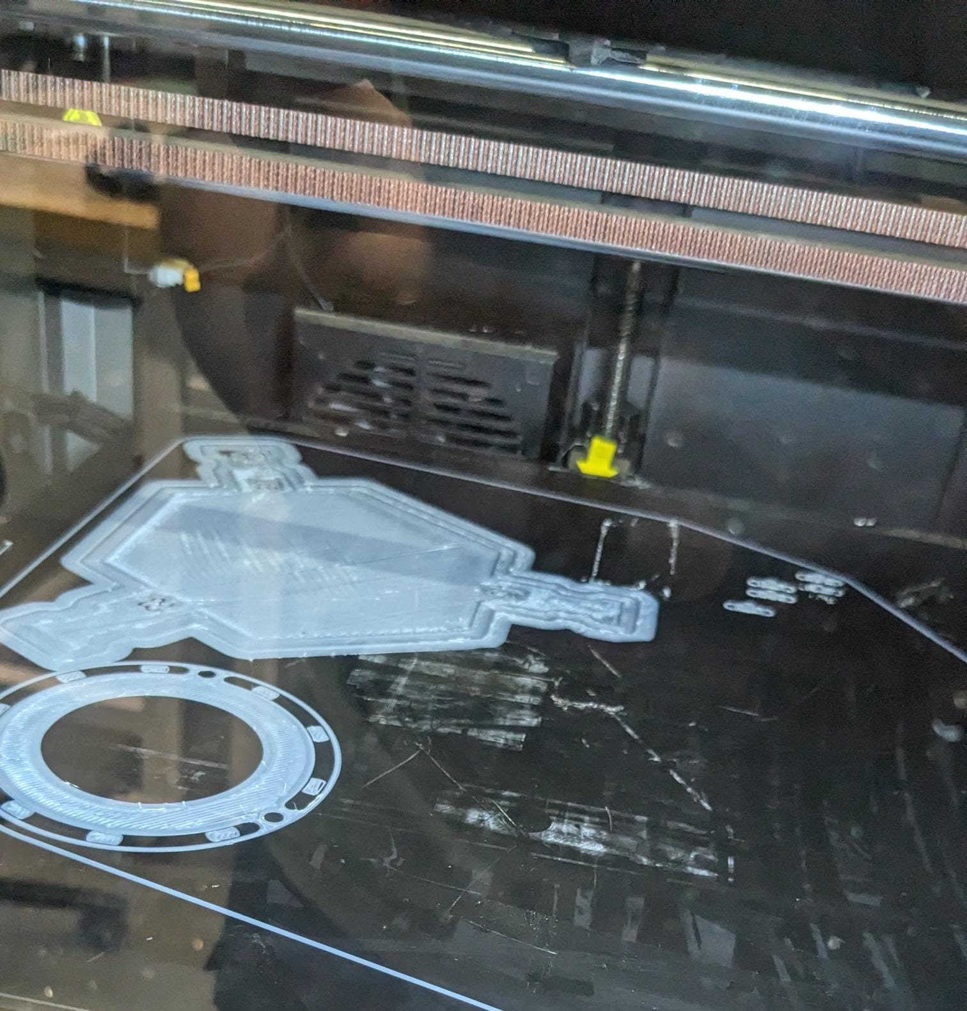
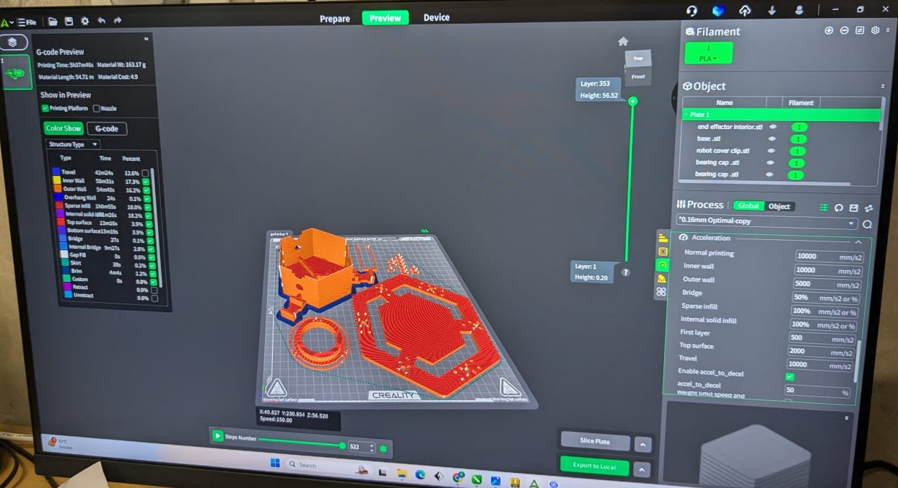
3D PRINTING

Slide 8
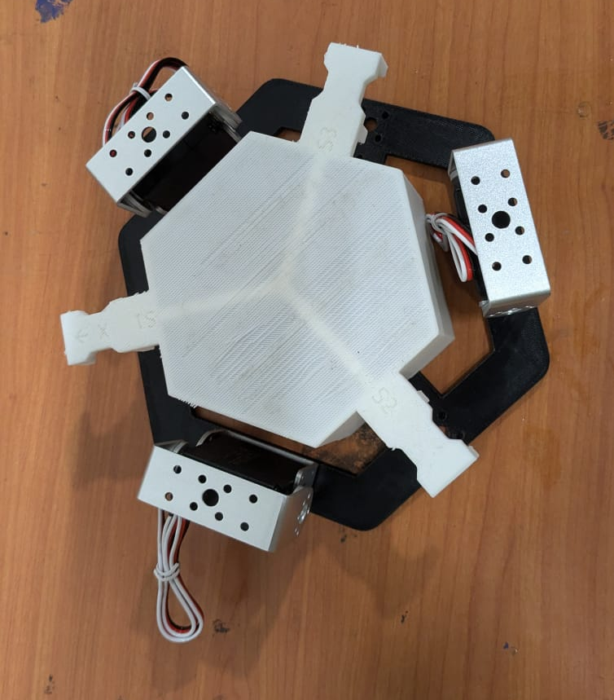
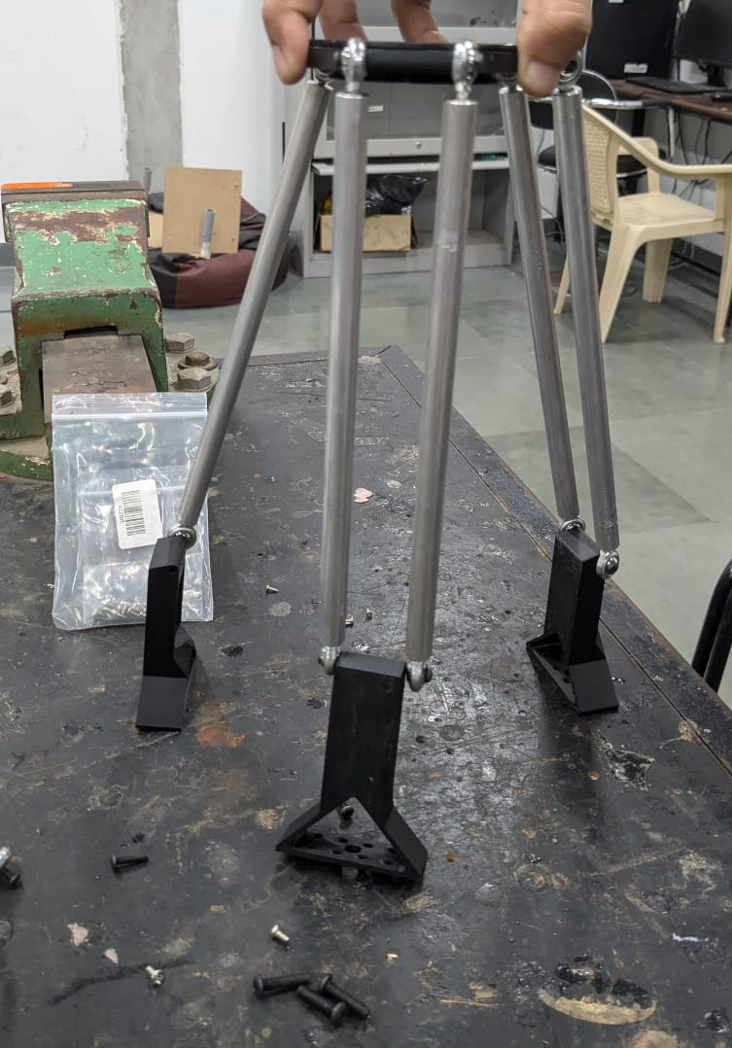
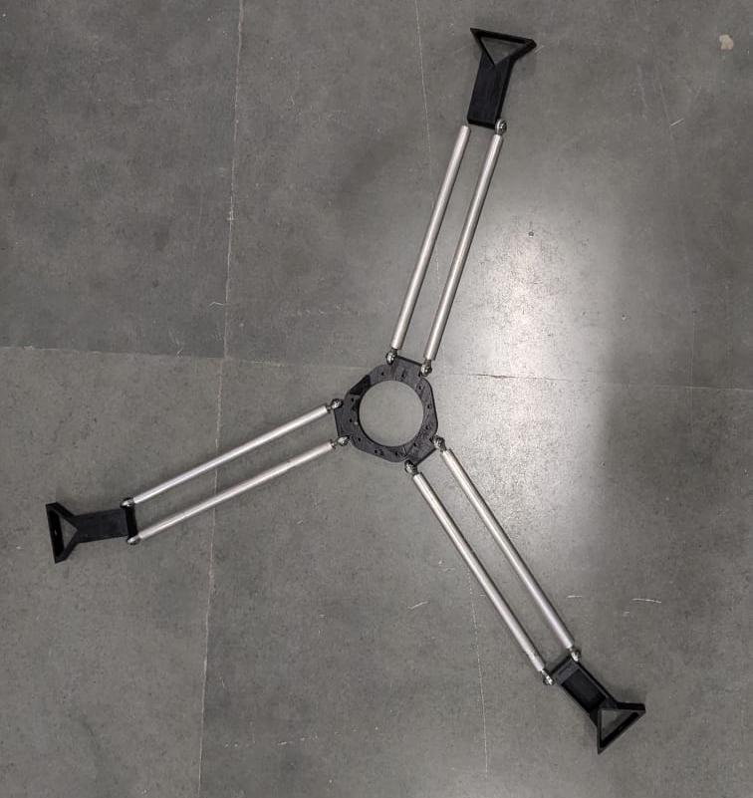
PROTOTYPE

Slide 9
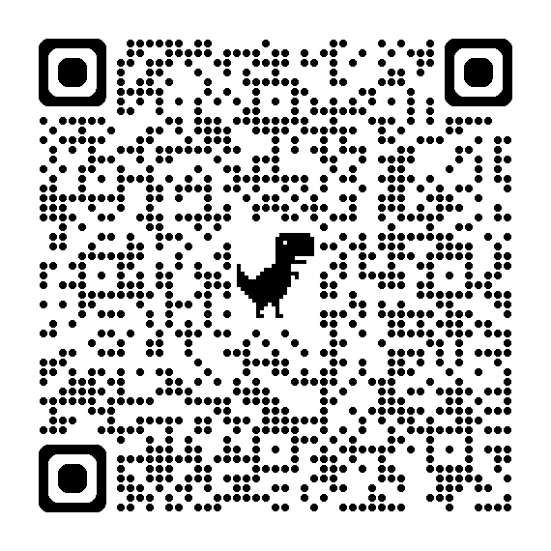
REFERENCES:
[I] https://images.app.goo.gl/w7wUYxAVPT8155v17
[II] https://www.thingiverse.com/thing:3465651

